Slide 1
SQL Modernisation What is SQL Modernisation and how do we approach it?

Slide 2

What is SQL modernisation, why is it important?
Notes:
SQL Modernisation is :
An Upgrade of SQL Server
Potentially an opportunity to Do things better

Slide 3








SQL MODERNISATION DRIVERS
Remove Legacy Hardware
Reduce Security threats
Meet Urgent capacity needs
Meet Compliance
Integrate acquisitions
Application upgrades
Data Modernisation
Reduce Data Centre costs
Remove Legacy Software
Notes:
Modernisation drivers from technical perspective

Slide 4
Pressure is mounting for organizations to stay relevant and get ahead.
Notes:
But Modernisation has an impact on Business and these ultimately fund move from old to new SQL server. But what is the Value? Can this be identified and measured? Who responsibility is it?

Slide 5
DATA OPTIMISATION is key to digital transformation
Priorities
Eliminate time spent managing “long tail” of applications—lift and shift to managed cloud
Free up limited IT resources to drive transformation
Migrate business critical apps to cloud—extend and innovate
SQL Server
37% of all units run Microsoft, >50% of units run 2008/R2 or older²
END OF EXTENDED SUPPORT WINDOWS 2008 AND SQL 2008 JULY 2019
¹ Pie Chart *IDC Worldwide DB Forecast Dec 2016
² Microsoft Internal Sources
Notes:
To stay competitive in today’s marketplace, IT organizations must continuously optimize how they maintain and use the data that fuels their operations. Modernizing to the cloud as part of a digital transformation can deliver:
Operational efficiencies
Business enablement to drive continued growth
IT optimization introduces some new priorities to consider:
Eliminating time spent managing “long tail” of applications
Freeing up limited IT resources
Migrating business critical apps to the cloud
Join the transformation wave: A December 2016 IDC study estimated 37% of the global database installed base runs on Microsoft SQL Server, with over 50% running on 2008/R2 or older.
​

Slide 6
But data is more complex than ever
Velocity
Real-time
Volume
ZB
Batch
GB
Structured data
Unstructured data
Each dimension of data is constantly expanding
Variety
Notes:
Big data affects SQL as well. As feeds and speeds increase, the OLTP and Reporting platforms also need to be available, scalable to deliver insights to Organisations?

Slide 7
DATA MATURITY Assessment
Finding the value of Modern Data Platform for Businesses
Data
Analytics
Decisions
Reactive
Informative
Predictive
Transformative
Data is used reactively and not used to inform businesss operation
Data is helping inform business of past events. It is not making predictions
Data is predicting future events and trends.
Data is transforming operations and driving new business opportunities.
Legacy SQL Server restrict Organisations to transform to a Modern Data Platform
Are you Here?
Take your own Data Maturity Assessment: https://datamodernizationplanner.azurewebsites.net
Notes:
To stay competitive in today’s marketplace, IT organizations must continuously optimize how they maintain and use the data that fuels their operations. Modernizing to the cloud as part of a digital transformation can deliver:
Operational efficiencies
Business enablement to drive continued growth
IT optimization introduces some new priorities to consider:
Eliminating time spent managing “long tail” of applications
Freeing up limited IT resources
Migrating business critical apps to the cloud
Join the transformation wave: A December 2016 IDC study estimated 37% of the global database installed base runs on Microsoft SQL Server, with over 50% running on 2008/R2 or older.
​

Slide 8
SO HOW CAN WE ELEVATE THE MESSAGE?

Slide 9




Technology is shaping how businesses innovate and grow
Engage your customers
Transform your products
Digital transformation
Empower your employees
Optimize your operations
Notes:
Why do we want to modernize our data estate?
In the modern climate of rapid change and innovation,, it is important to stay ahead of the curve.
As we have grown through our own digital Modernisation of our enterprise here at Microsoft, we realised that it is about 4 key pillars.
Its about empowering your employees with state-of-the-art tools. They (and you), need the best tools to be the best at their jobs
Deeply engaging with Customers in new and meaningful ways
Developing new and better products and services to better fit customer need
Finally, increasing operations agility while reducing costs.

Slide 10
Technology is shaping how businesses innovate and grow
Building Systems of Intelligence
Transform your products
Engage your customers
Optimize your operations
Empower your employees
Developing new and better products and services to better fit customer need
Deeply engaging with Customers in new and meaningful ways
Increasing operations agility while reducing costs.
Empowering employees with state-of-the-art tools. They (and you), need the best tools to be the best at their jobs
Notes:
Our key finding was that its critical to build feedback loops that unlock insights and innovations and actions, and the data is at the heart of this innovation.
(Pick your own industry specific example as required)
As an example Tesla captures driving telemetry from its cars and uses it to drive continuous, data-driven product innovation (Self parking, Auto Pilot, Smart Air Suspension) and uses the digital feedback loop to provide insights through telemetry, social media and customer adoption. This has Driven Tesla to a 20+ point mind share and in N America, outselling same in class BMW and Mercedes brands.
At the hear of this is data, which requires a Modern data estate to unlock your digital transformation priorities, lets have a closer look at those

Slide 11
A Modern data platform is your key to digital transformation
Transform your products
Engage your customers
Optimize your operations
Empower your employees
Developing new and better products and services to better fit customer need
Deeply engaging with Customers in new and meaningful ways
Increasing operations agility while reducing costs.
Empowering employees with state-of-the-art tools. You need the best tools to do your best work
Quickly integrate applications
Update legacy apps and build intelligence
Healthy cycle of innovation
Re-imagine business process with data and deep analytics
Accelerate the decision-making process with mission critical databases
Increase business agility across on-premise and the cloud
Reduce Data center costs through lift and shift at scale
Meet and exceed security and compliance
Refresh out of support Software and Hardware
Consistent tools and services
Data Estate Modernisation
Notes:
Summarize the impact
Now you can modernize your on-premise workloads to Azure, at scale, to meet your transformation priorities - across all workloads.

Slide 12
A Modern data platform is your key to digital transformation
Transform your products
Engage your customers
Optimize your operations
Empower your employees
Developing new and better products and services to better fit customer need
Deeply engaging with Customers in new and meaningful ways
Increasing operations agility while reducing costs.
Empowering employees with state-of-the-art tools. You need the best tools to do your best work
Quickly integrate applications
Update legacy apps and build intelligence
Healthy cycle of innovation
Re-imagine business process with data and deep analytics
Accelerate the decision-making process with mission critical databases
Increase business agility across on-premise and the cloud
Reduce Data center costs through lift and shift at scale
Meet and exceed security and compliance
Refresh out of support Software and Hardware
Consistent tools and services
Data Estate Modernisation
Increase visibility of real business value
Companies that embrace the cloud grow 19.6% faster
Companies have improved Productivity and innovation
Improve Performance and give better Customer Experience
Moving to PaaS will be the last upgrade you will ever do...
Total Economic Impact of Azure SQL Database Managed Instance – Forester Consulting 2018
Notes:
Summarize the impact
Now you can modernize your on-premise workloads to Azure, at scale, to meet your transformation priorities - across all workloads.

Slide 13
TOOLS FOR BUILDING YOUR BUSINESS VALUE

Slide 14
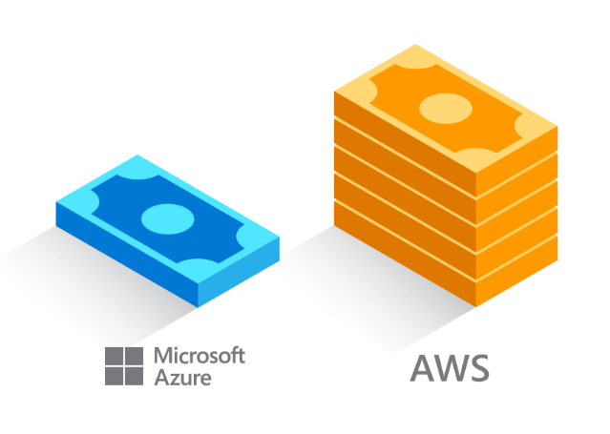



AZURE IS THE MOST COST-EFFECTIVE CLOUD FOR SQL SERVER
Azure Hybrid Benefit, an Azure-only benefit for customers with active SA or subscriptions on SQL Server cores
Significantly reduce the costs of migrating to the cloud
Pay only the ‘base rate’ in Azure on SQL Server on Azure VM (IaaS), Azure SQL Database (Paas), and ADF v2 SSIS
Available for SQL Server core licenses only
Customers can use on premises cores or cloud vCores
AWS is 5x more expensive than Azure
Azure vs. AWS homepage
5x substantiation page
Cores can be used on-premises and in Azure simultaneously for up to 180 days, to allow for migration
Azure TCO Calc
https://azure.microsoft.com/en-gb/pricing/tco/calculator/
Notes:
The Azure Hybrid Benefit helps maximize your existing investments in on-premises licenses with discounted rates on SQL Database.
*Note that the Azure Hybrid Benefit for SQL is an Azure benefit for customers with active Software Assurance (including subscription licensing) on their SQL cores.
Customers can use their licenses on premises, or as vCores towards eligible Azure data services.
By using this benefit, the customer is charged the ‘base rate’ in Azure, which excludes the charges. The ‘base rate’ is the cost of compute, storage, backup, and any I/O charges that may apply. SQL license costs are waived.
*Calculations based on scenarios running 744 hours/month for 12 months at 3-year Reserved Capacity. Prices as of 10/24/2018, subject to change. SQL Server calculations based on 8 vCore Azure SQL Database Managed Instance Business Critical in US West 2 running at Azure Hybrid Benefit rate. AWS calculations based on RDS for SQL EE for db.r4.2xlarge on US West (Oregon) in a multi AZ deployment for Reserved Instances under Standard 3-year term, all upfront payment. Extended security updates cost used for AWS is based on Windows Server Standard open NL ERP pricing in USD. Actual savings may vary based on region, instance size, and performance tier. Savings exclude Software Assurance costs, which may vary based on Volume Licensing agreement. Contact your sales representative for details.

Slide 15
Azure hybrid benefit for sql server
Take an inventory of on-premises licenses to determine potential for conversion
Convert on-premises cores to vCores to maximize value of investments
1 Standard license core = 1 General Purpose core
1 Enterprise license core = 1 Business Critical core
1 Enterprise license core = 4 General Purpose cores (virtualization benefit)
License trade-in values
SQL Server cores with SA license
vCores on Azure SQL Database
SQL Server Standard Edition
General purpose vCore
Business critical vCore
SQL Server Enterprise Edition
4x General purpose vCores
Notes:
SQL Server Enterprise Edition customers can use an unlimited virtualization benefit for their on-premises workloads. However, moving to the cloud to take advantage of its management, flexibility and cost benefits can be cost prohibitive for some heavily virtualized customers. The Azure Hybrid Benefit for SQL Server provides SQL Enterprise Edition customers with Software Assurance the ability to get 4 cores in the cloud for every 1 core they own on-premises for workloads moving to the General Purpose SKU – the SKU that best meets the requirements for highly virtualized workloads. This makes moving virtualized applications to SQL Database highly cost effective as customers will not have to purchase incremental vCores to move their virtualized application to the cloud.

Slide 16
RESERVED CAPACITY FOR AZURE SQL DATABASE
Prepay Azure SQL Database resources in advance and save up to 33%
Budget and forecast better with upfront payment for one-year or three-year terms
Exchange or cancel reservations as your needs evolve
Scale up or down within a performance tier and region with auto-fit
Move SaaS apps between elastic pools and single databases and keep your reserved instance benefit
Up to 55% savings¹
Up to 80% savings²
License included
With Azure Hybrid Benefit
Reserved Instances with Azure Hybrid Benefit
¹ Savings based on eight vCore Managed Instance Business Critical in East US Region, running 730 hours per month. Savings are calculated from full price (license included) against base rate (applying Azure Hybrid Benefit for SQL Server), which excludes Software Assurance cost for SQL Server Enterprise edition, which may vary based on EA agreement. Actual savings may vary based on region, instance size and performance tier. Prices as of May 2018, subject to change.
² Savings based on eight vCore SQL Database Managed Instance Business Critical in West 2 US Region, running 730 hours per month. Savings are calculated from on demand full price (license included) against base rate with Azure Hybrid Benefit plus 3-year reserved capacity commitment. Savings excludes Software Assurance cost for SQL Server Enterprise edition, which may vary based on EA agreement. Actual savings may vary based on region, instance size and performance tier. Prices as of May 2018, subject to change.
Notes:
Reservations help you manage costs across predictable and variable workloads and improve budgeting and forecasting with a single upfront payment, making it easy to calculate investments. While reserved capacity requires making upfront commitments on capacity, it also provides flexibility should your business needs change. You can easily exchange or cancel reserved capacity at any time.​
​
Manage costs across predictable and variable workloads.
Improve budgeting and forecasting with a single upfront payment, and calculate investments easily.
Maintain flexibility should your business needs change – you can easily exchange or cancel reserved capacity at any time.
Assign at the enrollment or subscription level, and manage your reserved usage at an organizational or individual department level.
For lowest TCO, combine reservation pricing (either 1- or 3-years) with the Azure Hybrid Benefit, or license-included prices.

Slide 17
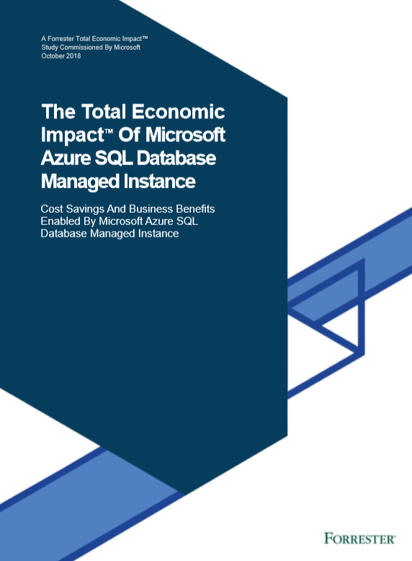
THE TOTAL ECONOMIC IMPACT OF AZURE SQL DATABASE MANAGED INSTANCE
Microsoft commissioned Forrester Consulting to conduct a Total Economic Impact™ study to examine potential cost savings and business benefits enterprises would achieve from migrating on-premises workloads to Azure SQL Database Managed Instance.
Key report benefits and findings
212% Total ROI
3 years after initial investment & migration to Azure SQL Database Managed Instance
$1.8M
Savings from avoided hardware, network, storage and ongoing maintenance costs
“
6 months or less
Payback post migration
Azure SQL Database Managed Instance is part of our strategic mandate to move all of our application, database, and services footprint to the Azure cloud. We can quickly integrate and are more nimble and more efficient as a result.
Head of development, technology company
“
40%
20%
Improvement in productivity for in-house DBAs
Increase in productivity for IT teams
Initial investment
Year 1
Year 2
Year 3
Download the full Total Economic Impact™ of Azure SQL Database Managed Instance report at aka.ms/ForresterTEI_SQLDB_ManagedInstance
Cost
Benefit
Notes:
You can achieve up to 212% ROI or more with SQL Database Managed Instance versus on-premises and hosted alternatives, according to recent Total Economic Impact report by Forrester. ¹
Organizations can experience this cumulative net benefit of nearly $2.2M over a 3-year period, by:
Lowering operational costs and redirecting resources to more value-add projects.
Relying on this fully-managed solution that requires near-zero administration for patching or upgrading.
Minimizing IT administrative costs, and reducing capital and operational costs associated with maintaining on-premises or hosted databases.
Shrinking costs associated with rearchitecting apps for the cloud.
Sources
¹ The Total Economic ImpactTM of Microsoft Azure SQL Database Managed Instance, Forrester Consulting, September 2018

Slide 18
WHAT IS THE PROCESS FOR MIGRATION?

Slide 19
Migrating databases to azure
Combining the best of SQL Server with the benefits of Azure
Migrating to SQL Server Databases to Azure has 3 key decision points:
Which Database deployment model is best for my Application?
What is the best process for migration to Azure?
What tools can I use to make migration more efficient?
And for All Up Modernisation – how do I do that at scale?
Notes:
SQL Database Managed Instance - recently generally available, Managed Instance is the best cloud destination for SQL Server workloads, combining the best of SQL Server with the benefits of a fully-managed, intelligent database services. Migrating to Managed Instance means virtually no code changes and no worries about end of support events.
SQL Database Managed Instance offers:
Simplified instance-scoped programming model that is like an on-premises SQL Server instance.
Managed Instance databases share allocated resources, with Managed Instance also representing the management grouping for these databases.
High compatibility, with the programming model of an on-premises SQL Server and out-of-box support for a large majority of SQL Server features and services.
An expansion of the existing SQL Database service, it’s designed to enable database migration to a fully-managed database service, without re-designing the application.
Experience the best of SQL Server combined with the operational and financial benefits of a fully managed and intelligent, cloud relational database service.

Slide 20
DEPLOYMENT OPTIONS IN AZURE

Slide 21
Modernizing your data estate unlocks significant benefits
Platform
(as a Service)
On-premises
Infrastructure
(as a Service)
New
Intelligent performance/security
On-premise costs tends to be driven by hardware and data center management costs
Infrastructure-as-a-Service reduces cost categories related to data center and compute
Platform-as-a-Service off-loads customers’ administrative tasks to Azure, further improving efficiency with machine-learning capabilities for performance and security
Managed Instance: instance-level deployment for lift-shift existing apps to Azure, fully backward compatible
Single database: database-level deployment for new app development
Applications
Applications
Applications
Data
Data
Data
High availability /DR/Backups
High availability /DR/Backups
High Availability/ DR/Backups
Database Provision/ Patch/Scaling
Database Provision/ Patch/Scaling
Resource Provider
Database Provision/ Patch/Scaling
O/S provision /patching
O/S
O/S
Virtualization
Virtualization
Virtualization
Hardware
Hardware
Hardware
Datacenter Management
Datacenter Management
Datacenter Management
Moving to “PaaS” realizes most time savings
SQL Server 2017
Azure SQL VMs
Azure SQL Database
Key
Managed by customer
Managed by Microsoft
Machine-learning capability
Total Economic Impact of Azure SQL Database Managed Instance – Forester Consulting 2018

Slide 22
SQL Database hosting options IN AZURE
Platform as Service
Infrastructure as Service
Azure SQL Database
Virtual Servers
Single + Hyperscale
Elastic Pool
Managed Instance
Azure Virtual Server
Database-scoped deployment option with predictable workload performance
Shared resource model optimized for greater efficiency of multi-tenant applications
Instance-scoped deployment option with high compatibility with SQL Server and full PaaS benefits
Extend infrastructure or move all to Azure
Best for apps that require resource guarantee at database level
Best for SaaS apps with multiple databases that can share resources at database level, achieving better cost efficiency
Best for modernization at scale with low friction and effort
Best for complete control over database instance and operating system environment
Azure Hybrid Benefit
100 Level + Compatibility , BACPAC, Elastic Queries, Service Endpoints,
up to 100TB Scale (Single DB)
Azure Hybrid Benefit
100 Level + Compatibility , CLR, Jobs, Mail, Cross DB Joins, Native Restore, Native Vnet integration,
8 TB Scale
Azure Hybrid Benefit (Resource Provider)
Full Flexibility, MSDTC, File stream, Polybase, Simple Recovery Model
Notes:
There are three hosting options available in Azure SQL Database:
Single database, assigning a certain amount of resources via performance tiers and focusing on a simplified database-scoped programming model and applications with a predictable pattern and relatively stable workload.
Elastic database pool is a shared resource model that enables higher resource utilization efficiency, with all databases within an elastic pool sharing predefined resources. This option focuses on a simplified database-scoped programming model for multi-tenant SaaS apps. The workload pattern is well-defined and is highly cost-effective in multi-tenant scenarios. For ISVs with SaaS apps, the savings can be significant, in the hundreds of thousands of dollars or more.
Managed Instance [click to next slide]

Slide 23








Migration of SQL Server to Azure PaaS
AZURE EXPRESSROUTE
AZURE
ACTIVE DIRECTORY
AZURE NETWORK
SECURITY GROUPS
AZURE KEY
MANAGEMENT SERVICE
OPERATIONS
MANAGEMENT SUITE
SQL
SQL
SQL
Azure
Data Factory
SSIS Integration Runtime
SQL Server
(IaaS)
Azure Analysis Services
Azure SQL DB
(PaaS)
SQL Server
(IaaS)
PowerBI.com
Modernise SQL to Azure PaaS
DB Migration Assistant
DB Migration Service
Redeploy
SQL
SQL
SQL
SQL
SQL
SQL
SQL Server
2008 +
SQL Server
< 2005
SQL Server
Integration Services
SQL Server
Analysis Services
Cubes
SQL Server
Analysis Services
Tabular
SQL Server
Reporting Services
On Premise

Slide 24
Database compatibility
Upgrade & modernize your SQL Server database on-premises, in the cloud and on the edge with Compatibility Certification that eliminates risks of application compatibility
Upgrade to the latest SQL Server Database Engine without changing your critical applications
Compatibility Certification benefits
Unified application certification
Applications tested and certified on a given SQL Server version are also implicitly tested and certified on that SQL Server version native database compatibility level
Reduce upgrade risks
Separate application and platform layer upgrade cycles for less disruption
Microsoft fully supports Compatibility Certification
Frictionless migration with no code changes
Upgrade to latest SQL Database Engine version
Upgrade your SQL Server Database Engine or move instances to the cloud with no code changes
Notes:
Starting with SQL Server 2016, the SQL Server team has stopped deprecating compatibility levels purposefully. The Database Engine is also literally the same accoss SQL Server and Azure SQL (including Managed Instance), so a database can be moved seamlessly and the same database code (T-SQL) works the same and undergoes the same optimization processes.​
Therefore, an application that was certified for compatibility 100 (SQL 2008) can work with the same behavior that was set for that version, even when moved to Azure SQL or a modern version of SQL Server.​
This means:​
•No more need to specifically certify for Azure or on-premises separately. Applications tested and certified on a given SQL Server version are also implicitly tested and certified on that SQL Server version native database compatibility level.​
•Reduced upgrade risks because during platform modernization, application and platform layer upgrade cycles can be separated for less disruption, and improved change management​
•Upgrading to a new version of SQL Server or Azure SQL can be done with no code changes by keeping the same compatibility level as the source​
New Databases are set to compatibility level mapping to the version of the Database Engine. When a database is upgraded from any earlier version of SQL Server, the database retains its existing compatibility level if it is at least minimum allowed for that instance of SQL Server or Azure SQL. Upgrading a database with a compatibility level lower than the allowed level (for example from SQL 2005), sets the database to the lowest compatibility level allowed.

Slide 25
SQL Server on Azure VM
What is Resource Provider?
SQL VM RP (Microsoft. SqlVirtualMachines) is a management service for SQL Server on Azure VM.
Brings the functionality of Azure Marketplace images to SQL Server instances self-installed on Azure Virtual Machines
Key customer benefits
Comprehensive feature set
Unified Dashboard view
Simple license conversions
Straightforward compliance

Slide 26
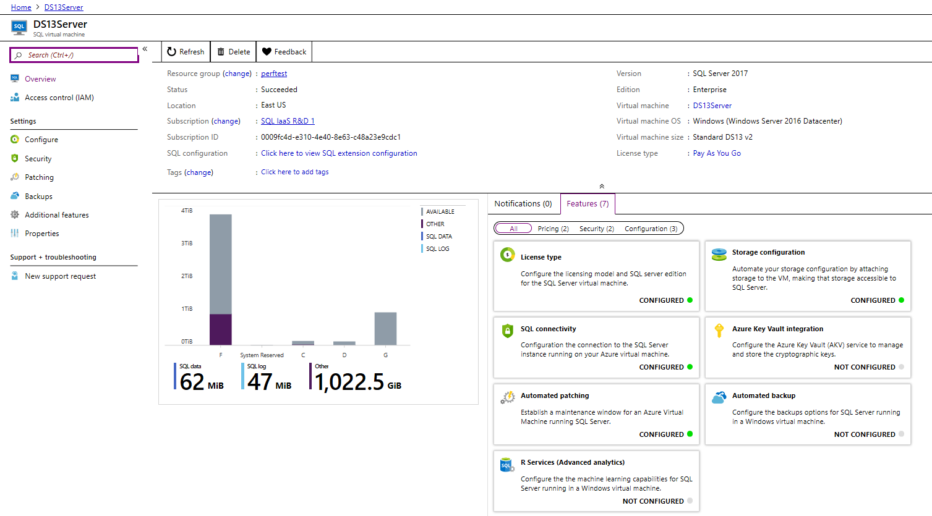
SQL on Virtual Machine – Resource Provider
Notes:
Now SQL virtual machines has their own “Manage” experience on Azure Portal exposing License type, edition and version.

Slide 27
Dedicated resources and familiar tools
Enable full isolation from other tenants without resource sharing
Promote secure communication over private IP addresses with native VNET integration
Enable your on-premise identities on cloud instances, through integration with Azure Active Directory and AD Connect
Combine the best of SQL Server with the benefits of a fully-managed service
Use familiar SQL Server features in SQL Database Managed Instance
VNET support in SQL Database Managed Instance
VNet-to-VNet
Web app (public IP)
VNet2
SQL instance #1
SQL instance #2
Network isolation (customer VNET)
Tenant isolation (compute, storage)
SQL instance #3
VNet1
“Virtual data cluster” dedicated to customer (virtual private cluster, VNET, private IPs)
VPN/Express route gateway
On-premises
Notes:
SQL Database Managed Instance provides complete workload isolation of your workloads through native VNET support. We use virtual data clusters to describe the degree of isolation that customer workloads will experience with SQL Database Managed Instance. During service provisioning (on Azure Portal or through REST API), you can choose the virtual network (VNET) and the subnet to achieve full networking isolation for your Managed Instances. Once created, instances in the VNET can be reached using Azure networking mechanisms (VPN and Express Route gateways).
To two levels of isolation are provided:
Cluster (tenant ring) level: Managed Instances for a tenant are fully isolated from other tenants. No connectivity or resource sharing is possible between different tenants.
Networking level: joining instances to a subnet in a VNET and restricting access to private IP addresses only provides full isolation from public Internet.

Slide 28
Committed to customer choice
Choice drives our approach to resource management and pricing
Simplicity
We remain committed to the DTU-based model and the simplicity it offers customers who want a pre-configured solution
Flexibility
The vCore-based model reflects our commitment to customer choice and to simplify the hybrid benefit for customers migrating from on-premises
Customers pay for:
Service tier + number of vCores
Type and amount of data storage
Number of IO*
Backup storage (RA-GRS)*
The vCore-based model will exist alongside the DTU-based model and will launch in public preview with no discount
 | General purpose |  | Business critical
Best for | Most business workloads. Offers budget-oriented balanced and scalable compute and storage options. |  | Business applications with high IO requirements. Offers highest resilience to failures using several isolated Always On replicas.
Compute tiers | Two hardware generations to choose from
 | Single/Elastic Pools | Managed Instance | Single/Elastic Pools | Managed Instance
 | 1 to 72 vCores | 8, 16, 24 vCores | 1 to 72 vCores | 8, 16, 24, 32, 40, 64, 80 vCores
Storage | Premium remote storage (per instance) |  | Super-fast local SSD storage (per instance)
 | Single/Elastic Pools | Managed Instance | Single/Elastic Pools | Managed Instance
 | 5GB – 4TB | 32GB – 8TB | 5GB – 4TB | 32GB – 4TB
Availability | 1 replica, no read-scale |  | 3 replicas, 1 read-scale**, zone-redundant HA***
Backups | RA-GRS, 7-35 days (7 days by default) |  | RA-GRS, 7-35 days (7 days by default)
* Free during preview
** Not supported in Managed Instance preview
***Coming soon
Notes:
It’s worth re-emphasizing that we’re committed to customer choice and as such, the DTU-based model and vCore-based models will both be available to SQL databases and elastic pools, offering simplicity and flexibility when it comes to resource management and pricing.
As with Managed Instance, the vCore-based model includes two options, differentiated by the level of HA and storage performance required by the your workload. These two options are General Purpose and Business Critical.
General Purpose is great for most business workloads. It offers budget-oriented, balanced and scalable compute and storage options.
Business Critical is great for business applications that have high IO requirements. It offers the highest resilience to failures using 3 isolated AlwaysON replicas with one read-scale.
Within these options, pricing will be based upon the number of vCores and storage and whether the license is included or if you’re using the Azure Hybrid Benefit for SQL Server to maximize your on-premises license investment.
The License Included option is available to all customers
The Azure Hybrid Benefit option is only available for SQL Server EE and SE customers with SA

Slide 29
MIGRATION PROCESS and tools

Slide 30



Routes to Data Platform Modernization
Migration
Pre-Migration
Post Migration
Migrate
On Premise
Azure
rehost
refactor
Optimise & Secure
Discover & Assess
rearchitect
Rebuild/ build new
https://azure.microsoft.com/en-gb/migration
Notes:
Gain Insight on current Architecture
Build Business Case
Plan and Pilot
Migrate Applications
Migrate Data / Schema
Migrate Components
Test
Remediate & Fix
Performance tweaks
Backups
Monitoring
Security / Audit

Slide 31
Routes to Data Platform Modernization in azure
rehost
refactor
rearchitect
Rebuild/ build new
Low friction legacy migration quickly is key
Description
Redeploy as-is to cloud
Minimally alter to take better advantage of cloud
Materially alter/decompose Data to services
New code written with cloud native approach
Reduce Capex
Free up datacenter space
Quick cloud ROI
End of Support SQL 2008
Legacy Migrations
Near 100% Compatibility
Low friction migration
Consolidation of instances
Database scale and agility
Easier adoption of new cloud capabilities
Mix technology stacks
Accelerate innovation
Build solutions faster
Reduce operational cost
Drivers
IaaS
PaaS
Managed Instance
(ADF, PBI, AAS)
PaaS
Azure SQL Database
(SQL DW / Cosmos DB / NoSQL / OSS)
PaaS
Managed Instance
Technologies
Results
IaaS: 435% ROI vs on premise, 73% reduction in datacenter footprint and 83% reduced IT outsourcing cost.¹
PaaS: 212% ROI, 20% to 40% time saved in support.
Automatic Updates to SQL and Operating System. Last Upgrade you will ever do
Notes:
Gartner: Developing a Public Cloud IaaS Adoption and Migration Framework, published March 2017.

Slide 32
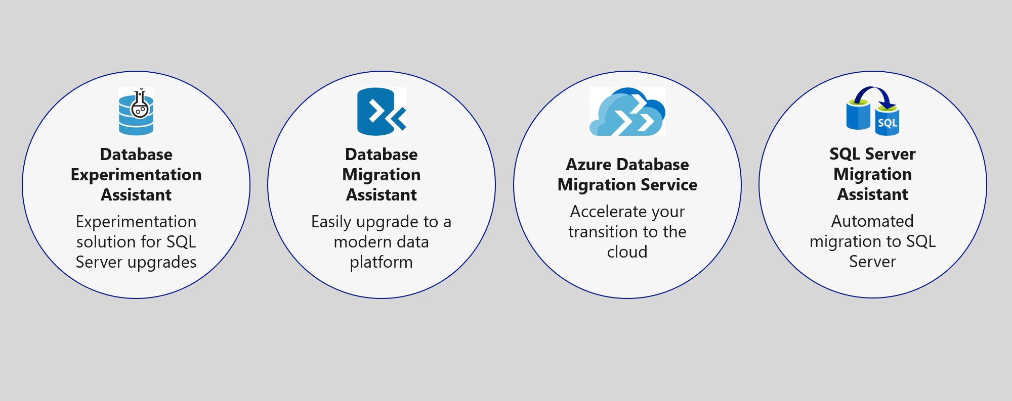
Upgrade & migration tools
NEW
Azure Migrate + DMS + DMA
Notes:
The Azure SQL data platform consists of three options:
SQL Server on an Azure VM
Azure SQL Database Managed Instance
Azure SQL Database
Each of the options will be discussed in more detail in the slides that follow.

Slide 33
Microsoft Tools for your migration journey
Azure Hybrid Benefit for SQL Server
SQL Server Migration Assistant (SSMA)
Automates database migration to SQL Server from Microsoft Access, DB2, MySQL, Oracle, and SAP ASE.
Data Migration Assistant (DMA)
Enables upgrade to SQL Server and Azure SQL Database.
Database Experimentation Assistant (DEA)
Assists in evaluating a targeted version of SQL for a given workload.
Migration Assessment Planning Toolkit
Discovery tool for SQL and Oracle workloads on premise.
Azure Migrate + Site Recovery
Lift and shift migration of VM’s from on premise into Azure.
Azure SQL Database
Azure Database Migration Service (Azure DMS)
A fully managed service designed to enable seamless migrations from multiple database sources to Azure Data platforms with minimal downtime
Offline and Online (Preview) migration tool for automating database migration into Azure.
NEW
On Premise
Azure Migrate + DMS + DMA

Slide 34
SQL DATA MIGRATION PROCESS Microsoft tools to accelerate your journey to the cloud during the migration lifecycle
Discover & Assess
Migrate
Optimise & Secure
Azure Database Migration Service (Azure DMS)
Data Migration Assistant (DMA)
Database Experimentation Assistant (DEA)
Remediate applications
SQL Server Migration Assistant (SSMA)
Functional & performance tests
Discover
Assess
Convert
Data Sync
Cutover
Migrate data, schema & objects
Optimize
Azure Migrate
MAP Toolkit
3rd Party Solutions
Data Migration Assistant (DMA)
Azure Database Migration Service (Azure DMS)
Near-zero downtime enabled (Preview) or 3rd party tools

Slide 35
Azure Database Migration Service
A seamless, end-to-end solution for moving on-premises SQL server, Oracle, and other relational databases to the cloud
Homogeneous sources
Resilient migration
Azure Database Migration Service (Azure DMA)
Scale migration
Heterogeneous sources
Orchestration

Slide 36
DATA MIGRATION METHODS SQL SERVER
Native way, just requires Blob Storage
Use when application can tolerate downtime, VLDB or disconnected to On premise
SQLDB requires BACPAC
Managed Instance native SQL BAK
BACPAC or BAK
Native commands, to Azure Blob Storage
Use in conjunction with Azure Data Transfer Services
Replication
Transactional, near-zero down time migration
Attunity, near-zero down time migration
Azure Database Migration Service
Needs to be setup, Attunity may require licenses
Use when application cannot tolerate downtime
Fully-orchestrated migration service logins and DB
On-line and Offline Migrations across an instance
SSIS Migration (Preview 2012 or above)
Notes:
Here are other migration options in addition to Data-In replication for MySQL as we just talked about.
Of course customers can use the familiar tools that exist today for dumping your database and importing into Azure, but of course this implies downtime for your application as once your dump your database, changes cannot be made to the original server until you import your data into the new server in Azure. This isn’t acceptable for most workloads – but is an option.
Attunity Replicate for Microsoft Migrations is a free-offering from Microsoft and Attunity that helps orchestrate the migration of data only from sources outside of Azure into Azure Database Services. This is similar to Data-In replication for MySQL, but provides a simple interface to set-up that is literally a “click and drag” migration operation. Additionally, this is extremely useful for PostgreSQL customers as there is currently not a Data-In migration solution for them today. However there are a few limitations, primarily that sources from other public clouds such as AWS or GCP are not supported.
Later this year, before the 2nd have specifically, we’re excited to bring forth the Public Preview of the Azure Database Migration service for MySQL and PostgreSQL. Unlike the Attunity solution above, DMS will provide additional source options such as AWS RDS.

Slide 37
WHERE TO GO TO GET STARTED

Slide 38
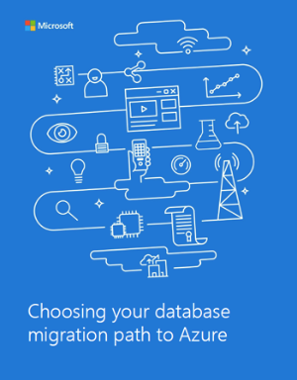
Migration cookbook
Migrate an on-premises SQL Server database to Azure SQL Database
The Migration Cookbook describes various approaches you can use to migrate an on-premises SQL Server database to the latest Azure SQL Database Update
Download: https://azure.microsoft.com/en-us/resources/choosing-your-database-migration-path-to-azure/en-us/
Notes:
Objective: The Migration Cookbook provides step-by-step recipes for migrating SQL Server databases to Microsoft Azure SQL Database using the preview of the latest SQL Database Update V12
Talking Points:
This cookbook focuses on the mechanical task of migrating a SQL Server database to the latest Azure SQL Database Update V12. If migration requires changes to the schema then the possible impact of each change on applications that use the database must be considered carefully. This cookbook assumes the reader is familiar with the schema of the database being migrated and the applications that use it and thus is able to assess the impact on the applications of any schema changes that might be required to allow the database to be migrated successfully.
Different approaches or ‘recipes’ for migrating a SQL Server database to Azure are described, each using one or more tools. Some recipes are quick and easy, while others take longer to prepare and ‘cook’. Migrating a large complex database may take many hours in a slow oven!
Azure SQL Database V12, the Azure management portal and the Visual Studio tools described here are all in preview and subject to change, so make sure you have latest versions of the cookbook and tools before you start.

Slide 39
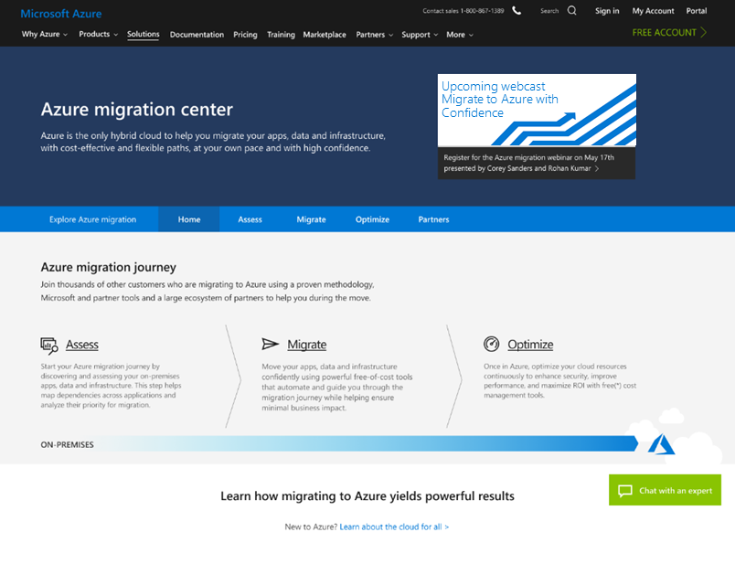
Your single destination for all things migration
Azure migration center
Provides guidance, tools, and partners in context of your migration scenario
Enables you to:
Build your case, find others like you
Assess your environment
Identify the right migration strategies
Optimize your cloud resources
Connects you to a migration expert
Chat enabled, backed by engineering resources
Guides you to FastTrack, partner, seller, or DIY outcomes
Azure.com/Migration

Slide 40
SUMMRY & TIPS
Start with the end in mind and consider the entire SQL Estate + Applications to drive efficiency.
Clear business case that focuses on Value, not just Savings. Pick a candidate to run a PoV / PoC.
Use the methodology to be build repeatable pipelines for migration.
If Modernising Many databases – use a Factory approach (>100 DB + at a time)

